Slide 1
D&D
Character Builder.
Coder Academy: T1A3 Assessment.

Slide 2
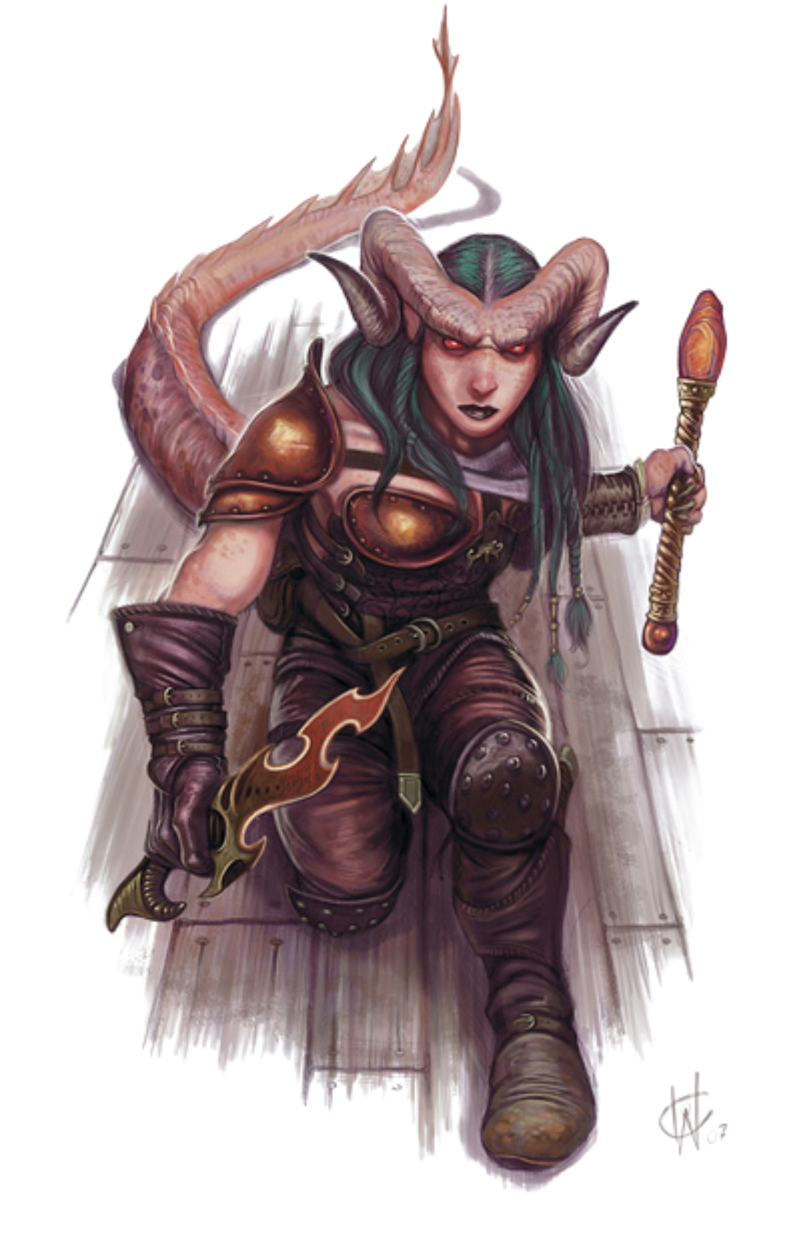
The Challenge:
To create a Dungeons and Dragons application that will make Character creation simple. To do this I have chosen to use the Faraday Gem to access a D&D API (This API is Based on the Fifth Edition of Dungeons and Dragons).
https://mythic-factions.fandom.com/wiki/Tiefling

